Slide 1
Prediction of Scoring Innings in Baseball
Capstone Project
Springboard Data Science Intensive
Kevin Wang

Slide 2
Introduction
Common complaint of baseball: long periods of little action
Casual fans often find watching batting (offense) more interesting than pitching (defense)
Most innings in baseball are scoreless
Is there a way to predict whether scoring will occur in an inning only given information available at the beginning of the inning?
Fans can decide whether to watch an inning at the beginning of it
Advertisers and broadcasters can predict most exciting parts of a game to show ads

Slide 3
Data Acquisition and Exploration

Slide 4
Data Acquisition
['GAME_ID',
'AWAY_TEAM_ID',
'INN_CT',
'BAT_HOME_ID',
'OUTS_CT',
'BALLS_CT',
'STRIKES_CT',
'PITCH_SEQ_TX',
'AWAY_SCORE_CT',
'HOME_SCORE_CT',
'BAT_ID',
'BAT_HAND_CD',
'RESP_BAT_ID',
'RESP_BAT_HAND_CD',
'PIT_ID’,
…]
MLB data available online in many sources
Retrosheet.org provides play-by-play files of every game in every season up to 2016
Event file format needs to be parsed to be readable by Python
3rd party tools available online to process data into .CSV files using R
96 different data fields available
For this project, use data from 2016 MLB season

Slide 5
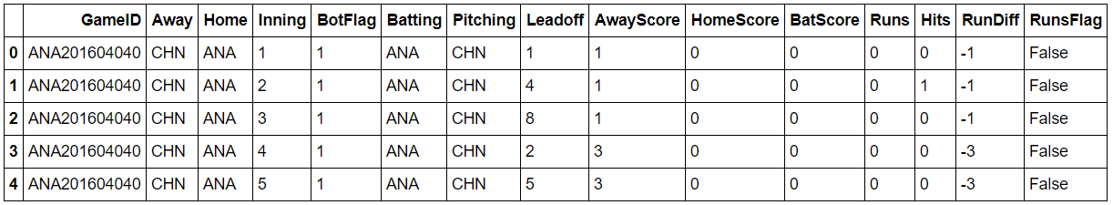
Data Cleaning
Many fields were not of interest, so a subset of data is selected to work with
The data is for each play instead of inning
Iterate through to produce a compressed data frame where each row is an inning instead of a play
Additional fields generated such as a True/False flag denoting whether runs scored in an inning
This flag will eventually be the dependent variable Y for the classification

Slide 6
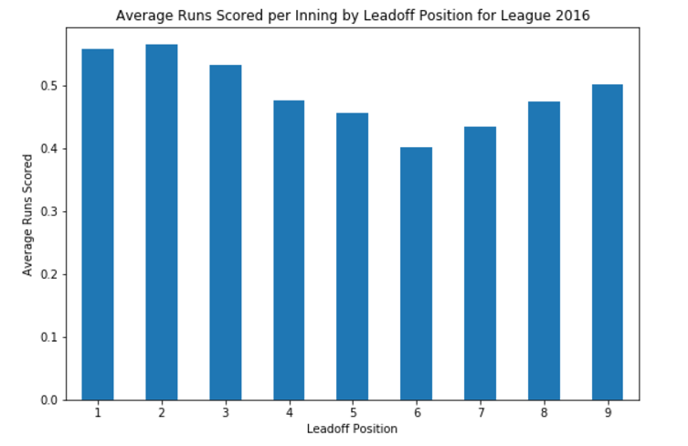
Data Exploration

Slide 7
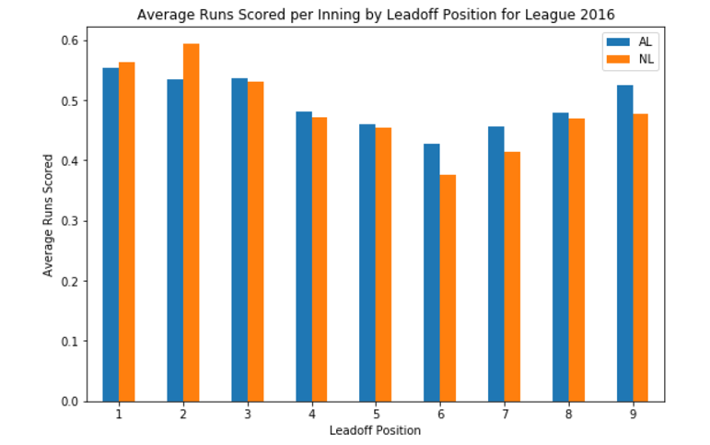
Data Exploration

Slide 8
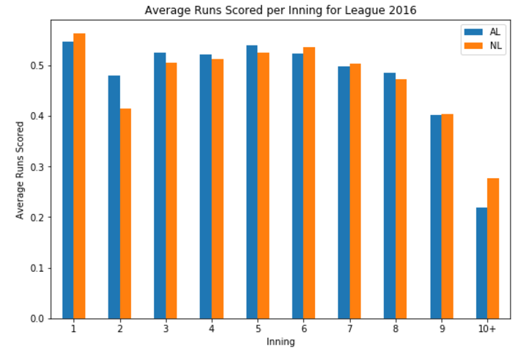
Data Exploration

Slide 9
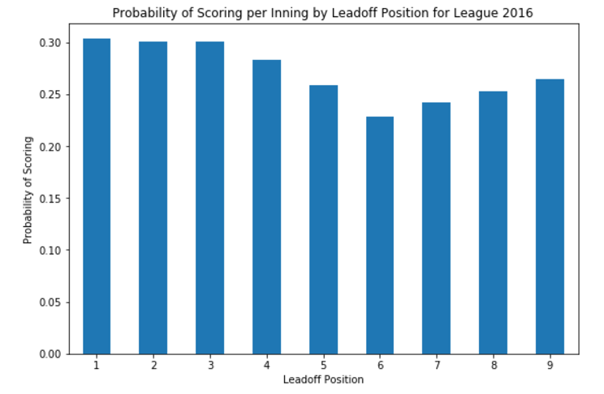
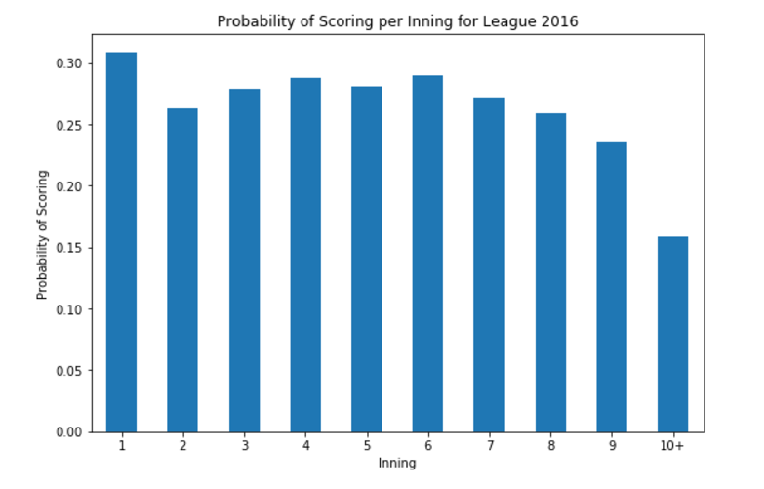
Data Exploration

Slide 10
Data Exploration Summary
Leadoff Position: Batting Order Number of player leading off for a particular inning
American League uses Designated Hitter in place of pitcher batting
Suspected to lead to better offensive numbers
Clear trend of scoring amount based on leadoff position and inning number
Consider these features in future models
Trend is mirrored for plots involving probability of scoring instead of average number of runs scored

Slide 11
Preliminary Modeling

Slide 12
Logistic Regression
Since it is a binary classification problem (T/F for runs scored in inning), consider Logistic Regression
Use scikit-learn package from Python
Train-test split on data to form training/test sets
GridSearchCV to tune parameters
For Logistic Regression, tune regularization parameter C
Results: Decent accuracy, but poor precision/recall
Confusion matrix shows problem
Model predicts everything as False
Runs scored? | False | True
False | 7904 | 2961
True | 0 | 0

Slide 13
Random Forests
Maintain same train-test split, tune parameters with GridSearchCV as well
Results: better, but still poor
Comparison of scoring metrics:
More tuning needed
Adding additional features did not help much
Consider the imbalanced data
Runs scored? | False | True
False | 7700 | 2888
True | 204 | 73
 | Accuracy | Precision | Recall
Logistic Regression | 0.727473538886 | 0.0 | 0.0
Random Forest | 0.716244822826 | 0.031746031746 | 0.303225806452

Slide 14
Imbalanced Learning
Data: roughly 30-70 split for True/False
Consider using imbalanced learning techniques with Logistic Regression
Stratification: no real change observed
Oversampling
Undersampling
 | Accuracy | Precision | Recall
Training | 0.533274197977 | 0.475880713019 | 0.537576943265
Test | 0.528986884623 | 0.465788139888 | 0.533217290397
Runs scored? | False | True
False | 4673 | 4216
True | 3218 | 3676
 | Accuracy | Precision | Recall
Training | 0.534895453781 | 0.418096199125 | 0.545494441194
Test | 0.528838069615 | 0.41492938803 | 0.537456445993
Runs scored? | False | True
False | 1911 | 1740
True | 1062 | 1234

Slide 15
Imbalanced Learning
Oversampling: shows better precision
Use of stratification and oversampling at same time
Logistic Regression
Seemingly not much better than assigning T/F at random
Perhaps not an appropriate model for the problem
Move on to other classifiers while maintaining use of imbalanced learning techniques

Slide 16
Classifier Testing and Selection

Slide 17
Classifier Testing
Test several different classifier algorithms, and compare scoring metrics to determine the best model
Perform parameter tuning using GridSearchCV
Calculate accuracy-precision-recall for test sets
Calculate training scores or OOB scores for Random Forests
Generate ROC-AUC curves when appropriate
Maintain use of stratification and oversampling
Continue using same features as before
Numeric: Inning, Leadoff Position, Score Differential
Categorical: Team Batting, Team Pitching
Encoded using One-Hot Encoding

Slide 18
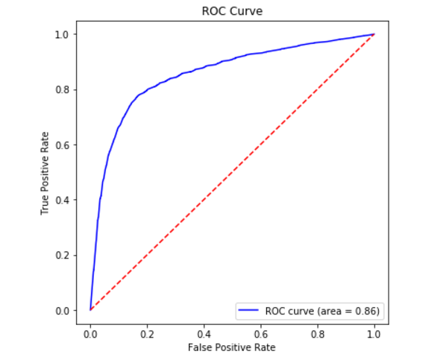
Random Forests
 | OOB Score | Test Accuracy | Test Precision | Test Recall
Value | 0.768400599801 | 0.778812646518 | 0.839077546883 | 0.7488408911
Solid results for all scoring methods
Decent runtime
Good AUC score from ROC curve

Slide 19
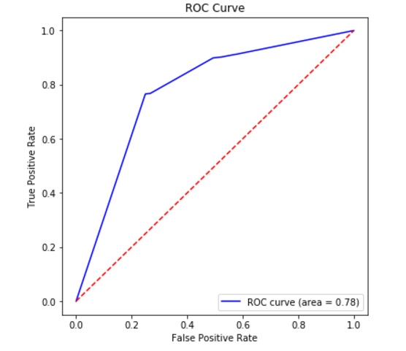
K-neighbors Classifier
 | Accuracy | Precision | Recall
Training | 0.920990939619 | 0.875897609192 | 0.962718789173
Test | 0.750364316036 | 0.767359351242 | 0.742156862745
K=2 selected by GridSearchCV
Evidence of overfitting
Longer computation time
Scoring not quite as good as Random Forest

Slide 20
Support Vector Machines
SVC: extremely long runtime
Max iterations had to be reduced so GridSearchCV could finish
No longer converged (Tuning accuracy: 0.52)
Increase iterations for final estimate of scores
Still did not converge completely
LinearSVC
Faster than SVC, but poorer performance
Default iterations: not unbounded
Likely also did not converge
Conclusion: SVMs have potential, but are severely handicapped by hardware limitations
SVC | Accuracy | Precision | Recall
Training | 0.769055312678 | 0.765143195066 | 0.771169483588
Test | 0.637458024457 | 0.681829700963 | 0.626280260708
LinearSVC | Accuracy | Precision | Recall
Training | 0.53749815202 | 0.53007518797 | 0.538052566136
Test | 0.526832668061 | 0.511657374557 | 0.527705175118

Slide 21
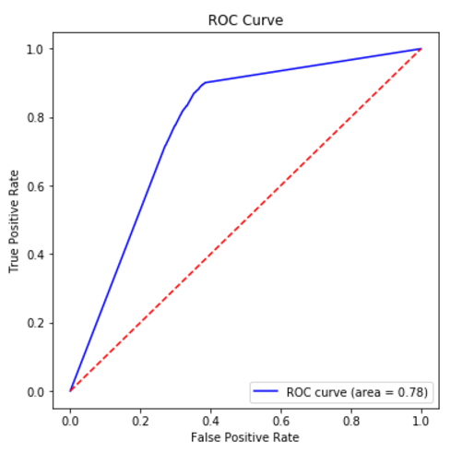
Decision Tree Classifier
 | Accuracy | Precision | Recall
Training | 0.942490865699 | 0.949607163977 | 0.936279205364
Test | 0.750554393968 | 0.834262544349 | 0.714642353197
Default parameters selected
Evidence of overfitting
Decent computation time
Comparable to Random Forest, but not as good

Slide 22
Conclusion and Recommendations

Slide 23
Final Model
Select Random Forest model due to good scoring and runtime
Features Used
Numeric: Inning, Leadoff Position, Score Differential
Categorical: Team Batting, Team Pitching
Binary T/F classification for whether runs scored in an inning
Use stratification and overfitting to combat imbalanced data
Consider effect of random seed on train-test split, random forest generation
Generate several trials with different random seeds, and plot the scoring metrics for each iteration

Slide 24
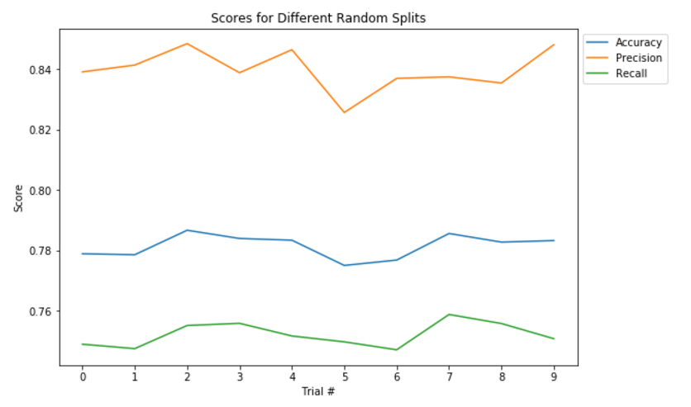
Final Model
Scores remain stable, so remain confident in model’s ability to successfully classify the data

Slide 25
Conclusion
Models can predict with roughly 75% accuracy whether there will be scoring in a half-inning based only on information available at the beginning of the half-inning
Random Forest Classifier had the best performance
Recommend taking note of inning, leadoff position, teams playing, and score differential at the beginning of an inning
Can input these features into model to get rough estimate of whether scoring will occur

Slide 26
Future Recommendations
Consider more modeling algorithms
Change dependent variable
Define “interesting” inning differently: More than 2 hits, homerun T/F, etc.
Use numeric variable like number of runs scored
Opens door to regression models in addition to classification models
Add features from other datasets
Player statistics, time of day, team record, etc.
Consider more seasons of data
Better hardware recommended for faster processing

